Slide 1
QlikSense Training
I&D India – QlikSense CoE

Slide 2
Session 01

Slide 3
Session Agenda
Introduction to QlikSense
Why Analytics?
Understanding Signal and Noise
Understanding Data

Slide 4
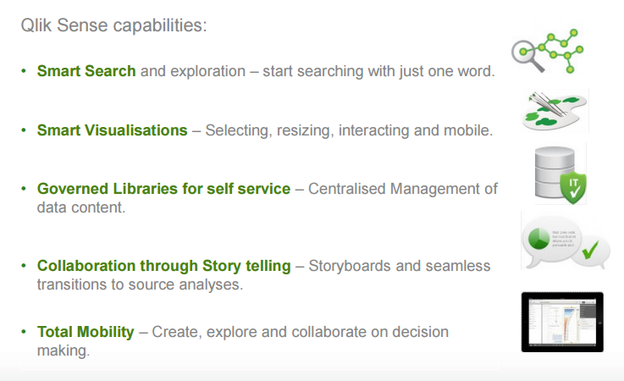
Introduction to QlikSense
Qlik Sense is a platform for data analysis. With Qlik Sense you can analyze data and make data discoveries on your own. You can share knowledge and analyze data in groups and across organizations. Qlik Sense lets you ask and answer your own questions and follow your own paths to insight. Qlik Sense enables you and your colleagues to reach decisions collaboratively.
Next-generation self-service Data visualization application.
Empowers everyone to create interactive visualizations using their intuition.

Slide 5
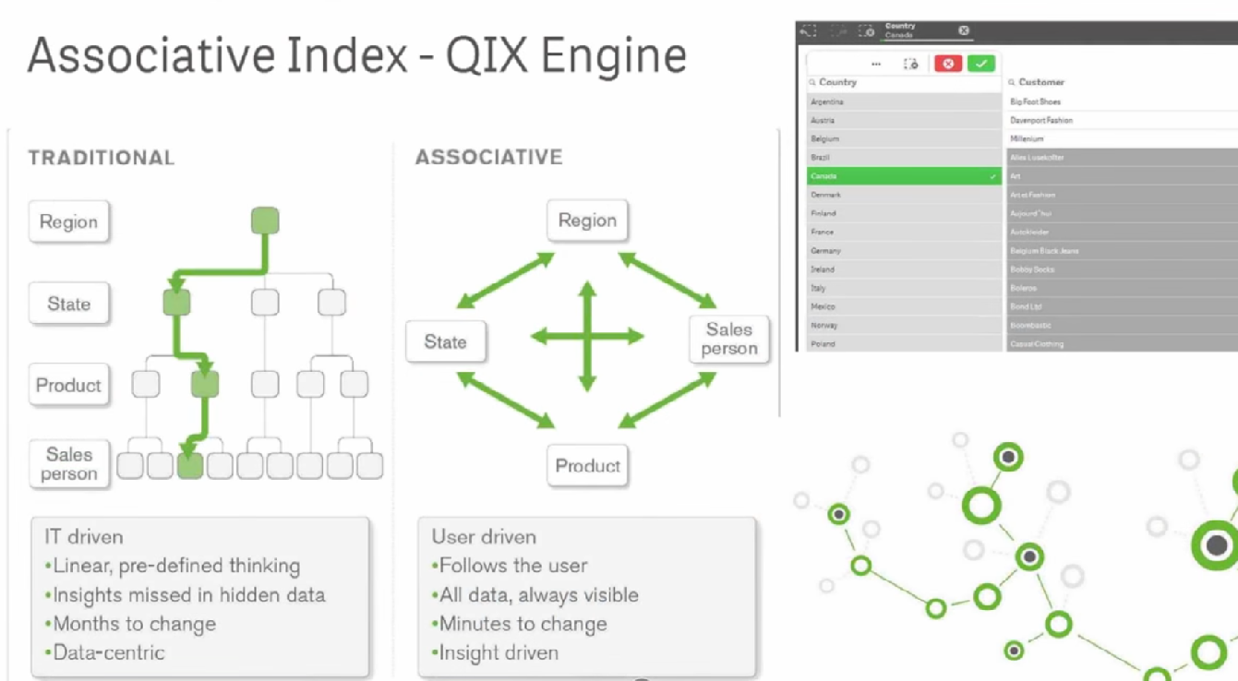
Introduction to QlikSense

Slide 6
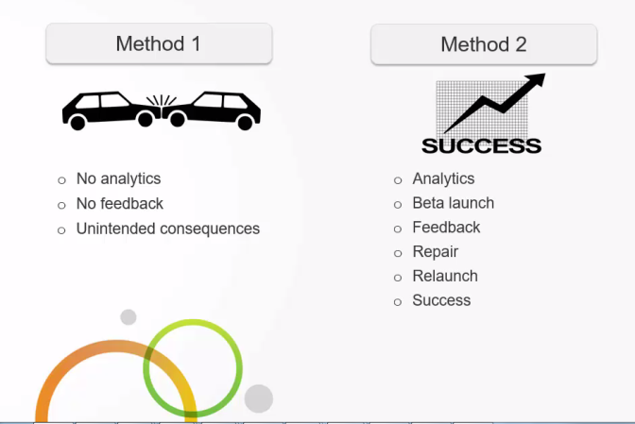
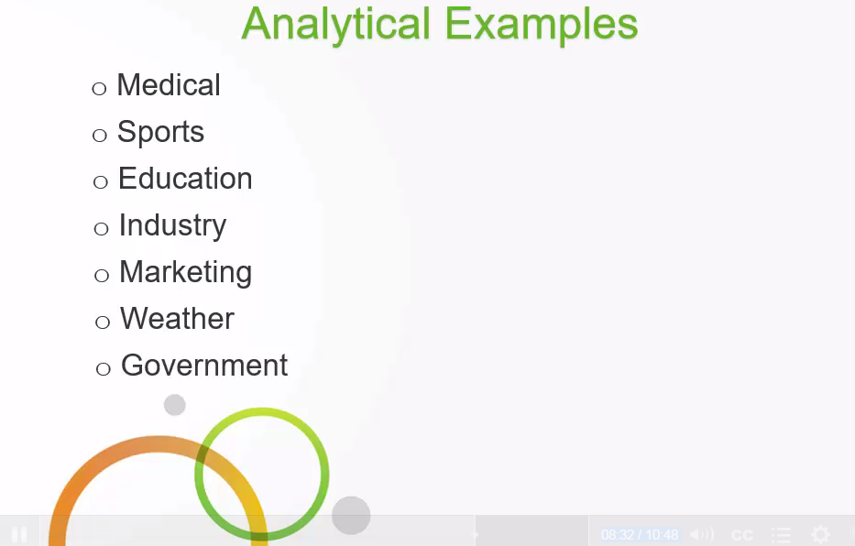
Why Analytics?
Using Data and Information to make informed decisions
To measure and track your results across time
To understand your visitors, leads, prospect
To understand, track and improve the mechanisms used to convert your first visitor into a valuable customers.

Slide 7
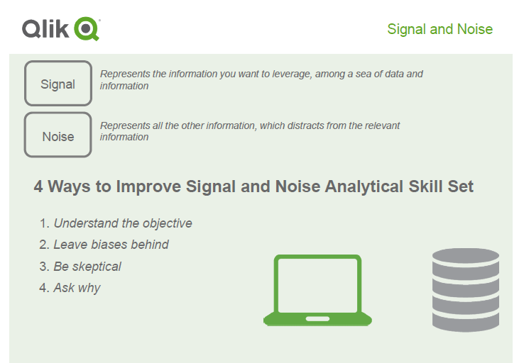
Signal and Noise
To measure and track your results across time
To understand your visitors, leads, prospect
To understand, track and improve the mechanisms used to convert your first visitor into a valuable customers.

Slide 8
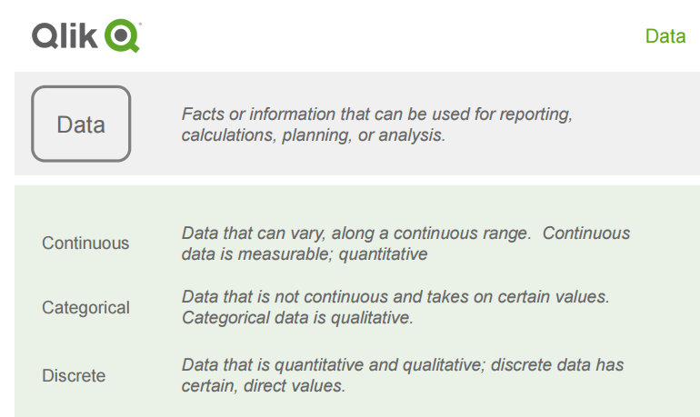

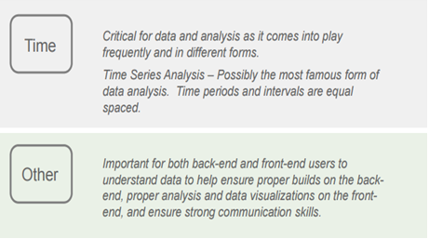
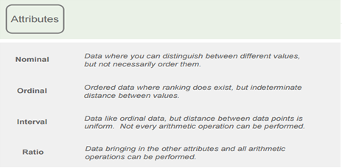
Understanding Data?
Gain an understanding of data
Learn about different types and attributes of data
Understand why learning about data is important in the world of analytics today

Slide 9
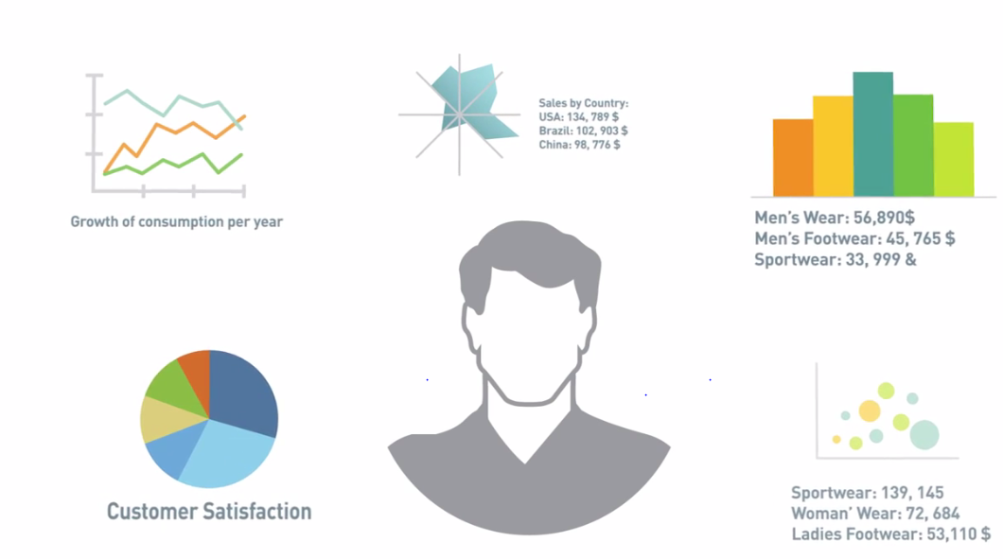
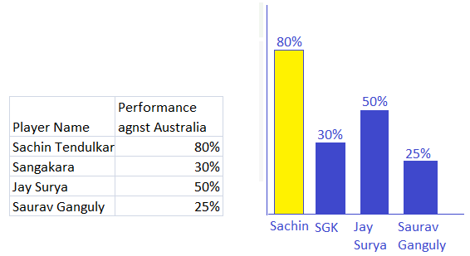
Foundations of Building Visualizations
Data visualization is the presentation of data in a pictorial or graphical format. It enables decision makers to see analytics presented visually, so they can grasp difficult concepts or identify new patterns. With interactive visualization, you can take the concept a step further by using technology to drill down into charts and graphs for more detail, interactively changing what data you see and how it’s processed.
Visualization should serve a clear purpose and not over around the user with unnecessary details.
If possible visualization should be designed to encourage the user to compare its various elements ,so as to give inside meaning behind of the data.

Slide 10
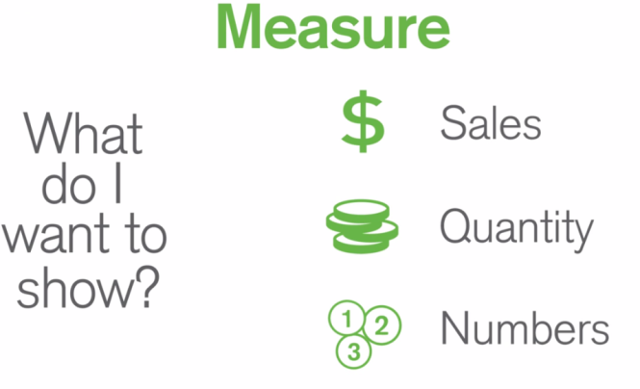
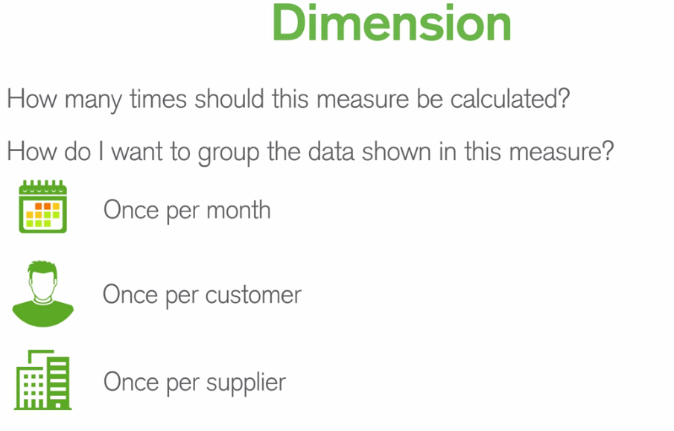
Understanding Dimensions and Measures
To create the visualization first we need to understand the data.
Understanding how your data to be classified will help to determine which chart type is best suited for representing your data.

Slide 11
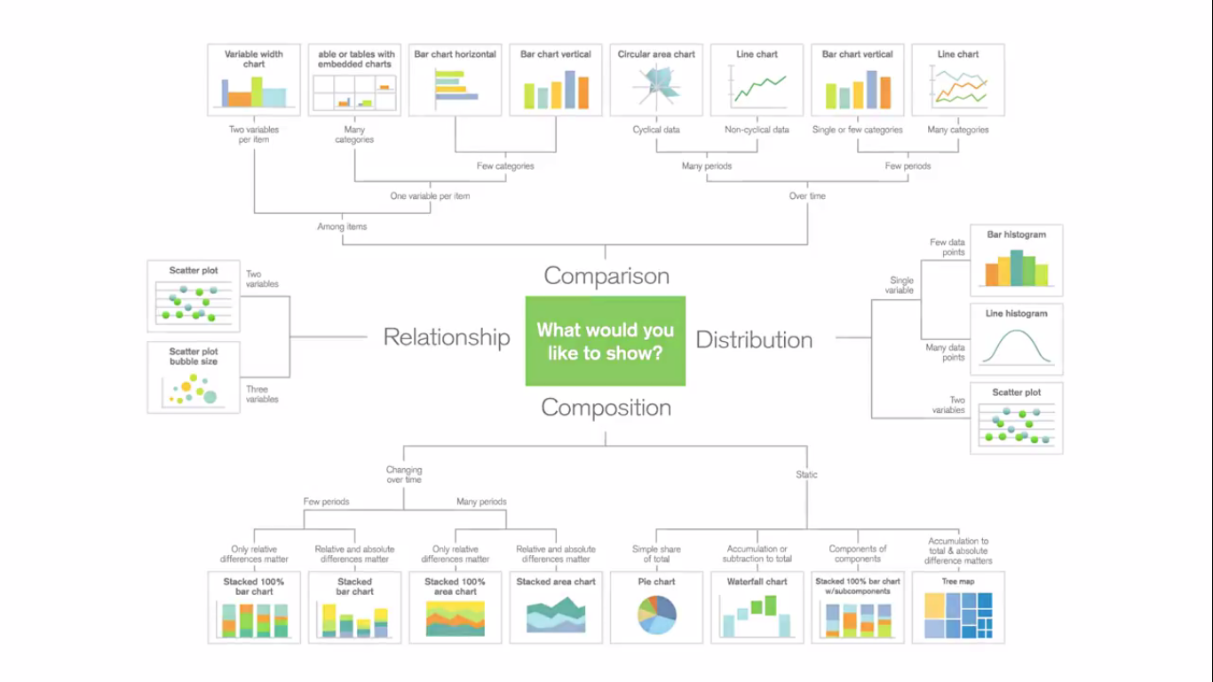
Visualizations Preview

Slide 12
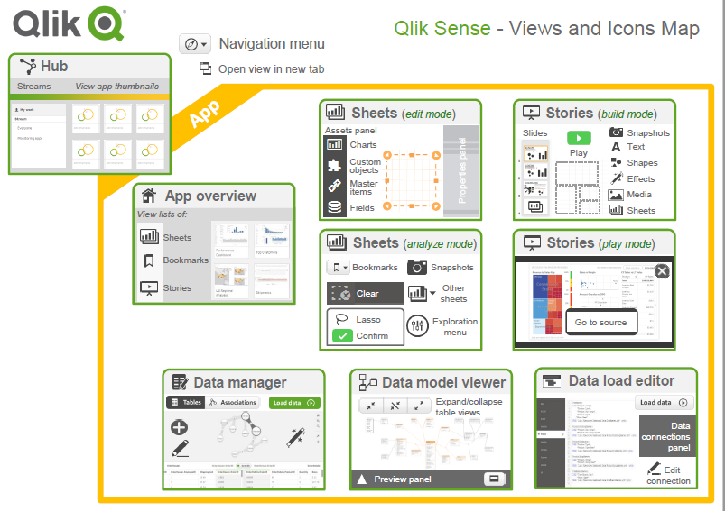
QlikSense App Navigation

Slide 13
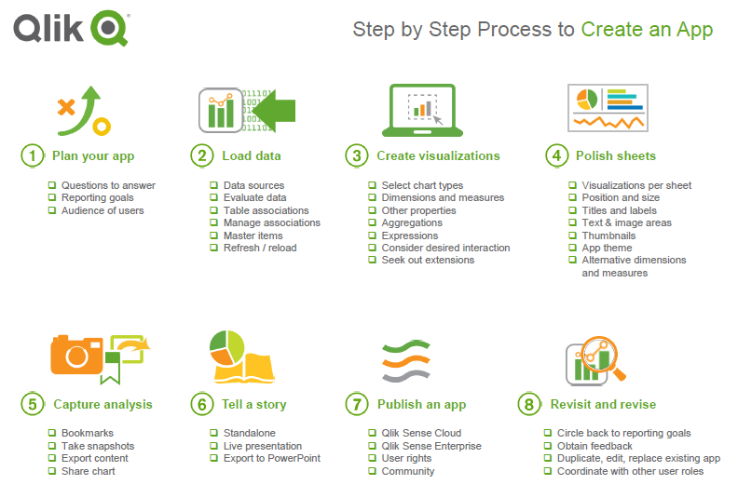
Create a Simple App

Slide 14
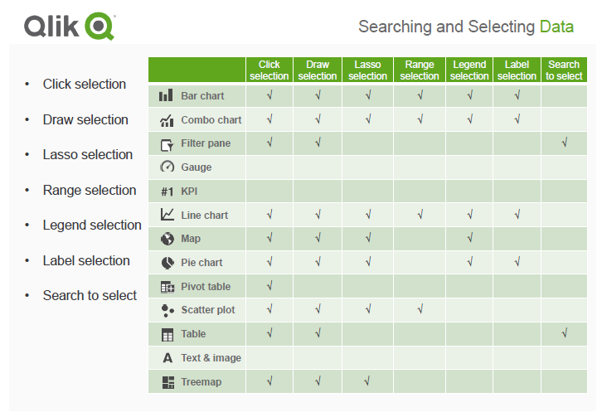
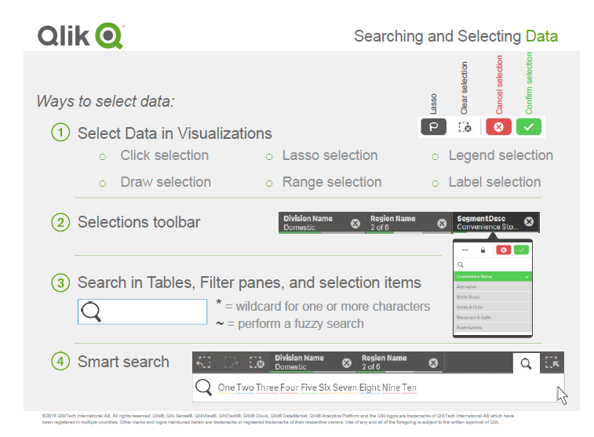
Select Data
Understand the associative selection model
Know how to select data in visualizations
Appreciate the value of the selections bar and selections tool

Slide 15
Thank You

